Slide 1
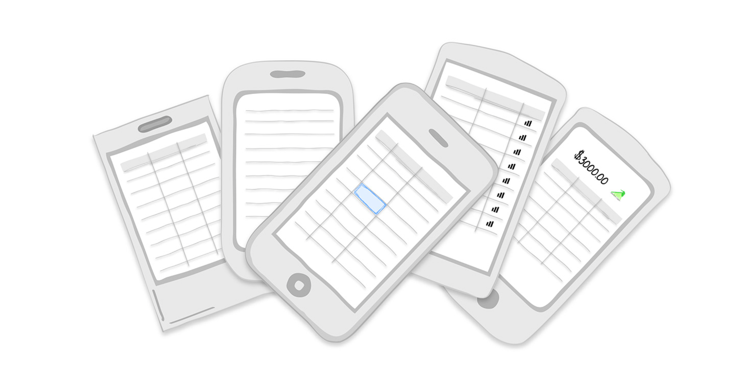
Tables

Slide 2
Displaying tabular data in mobile presents a challenge and an opportunity.
The challenge is finding usable ways to display the data on small screens.
The opportunity is that we can take a more critical view of the data to determine what the user really needs to take away from it, and then develop creative solutions to display the data so that it will be even more useful.

Slide 3
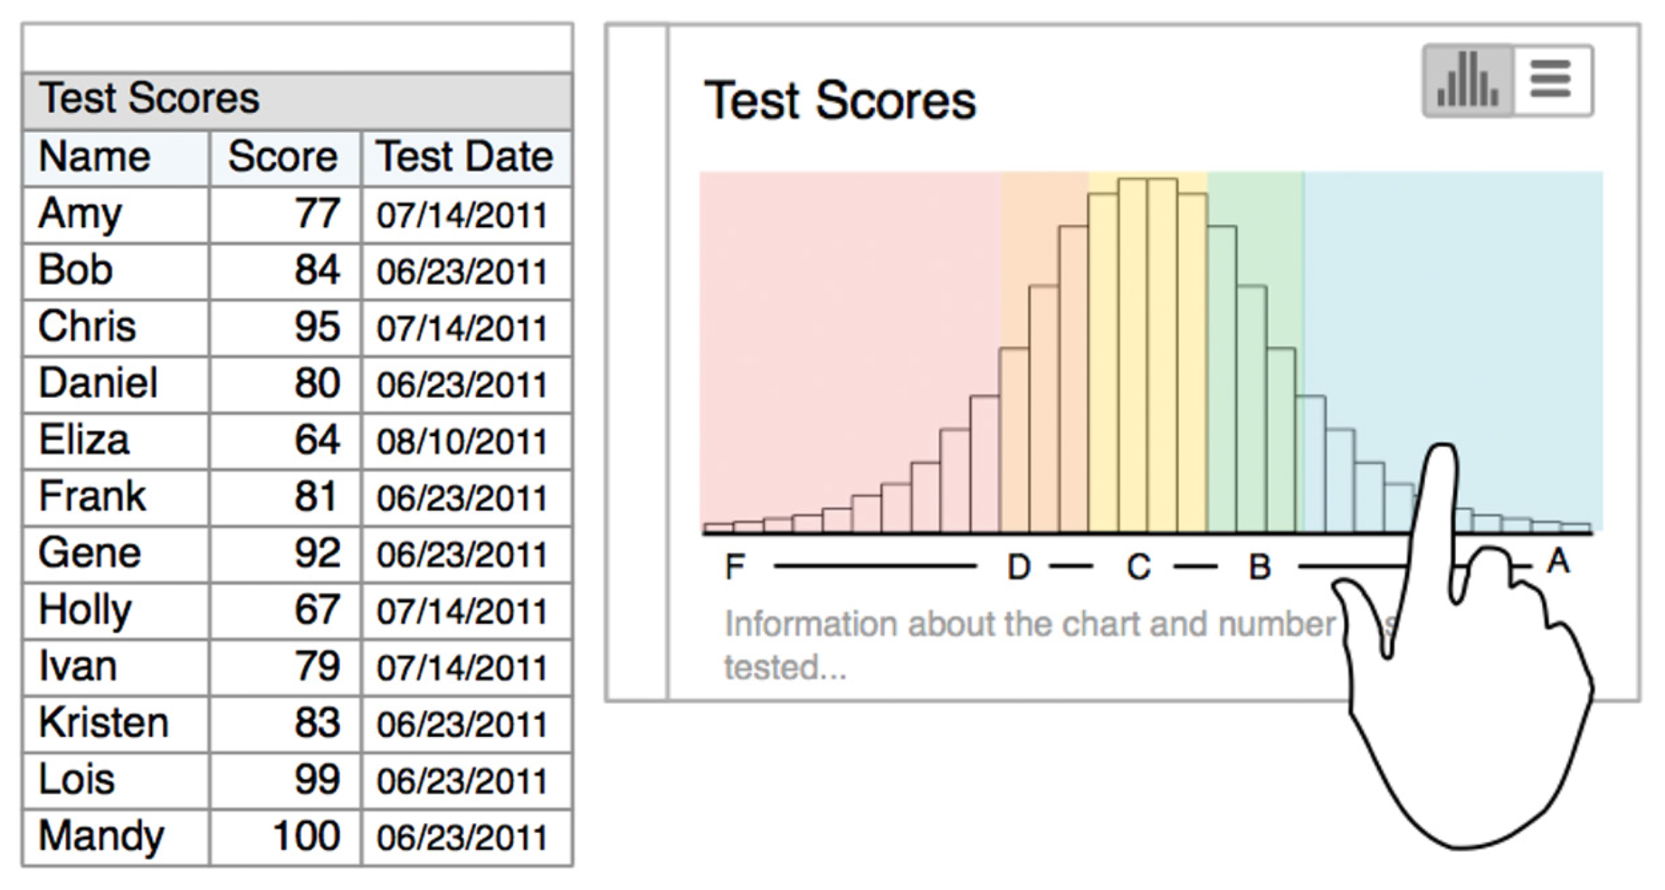
A long table of student test results can be better represented as a chart that users can drill into to see all students who scored in a certain band of the bell curve.

Slide 4
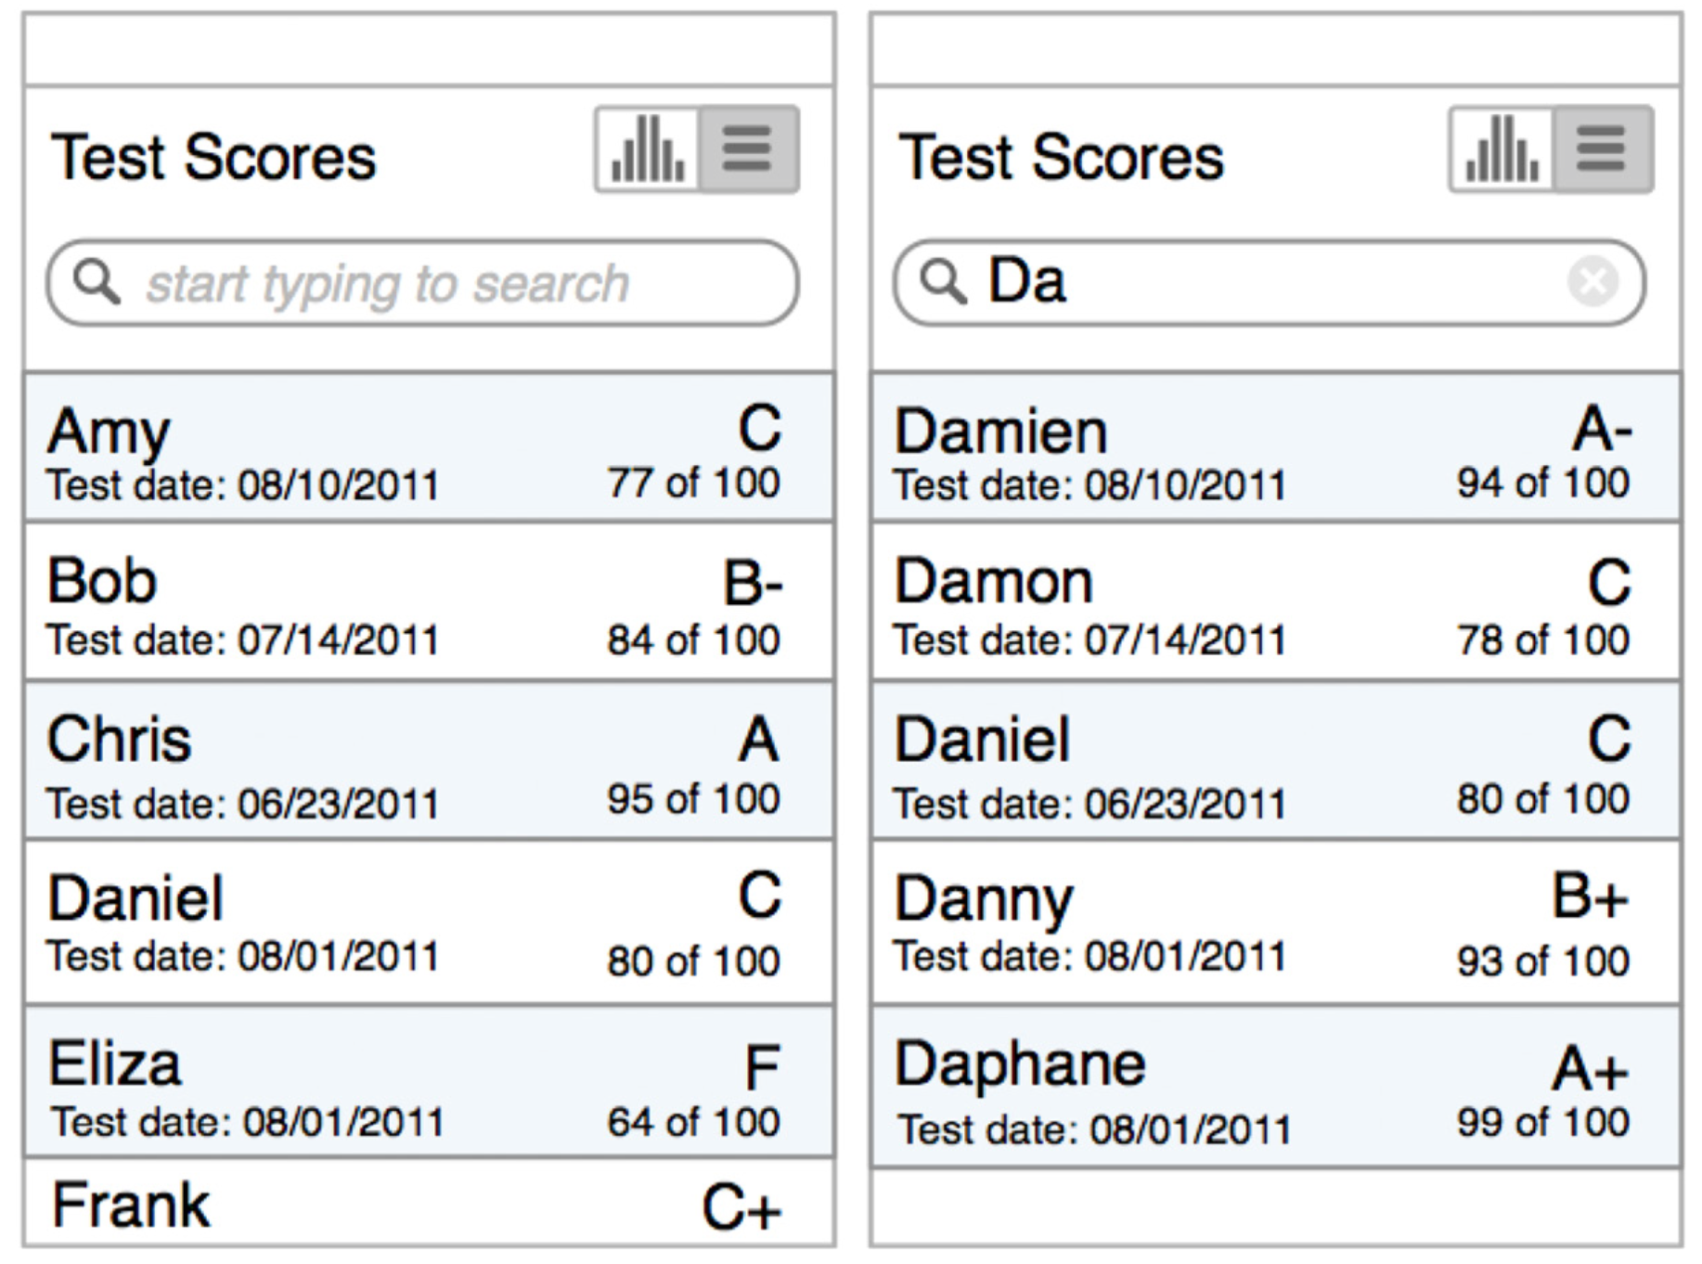
And for an alternate view of the information, we can provide a Headerless Table with Dynamic Search for quickly accessing a specific student’s results.

Slide 5
Once you’ve identified the key data your app needs to display, check out the following table patterns for inspiration.

Slide 6
Basic Table
The Basic Table pattern is just a standard table with fixed column headers and a grid layout. Alternating table row colors, also called zebra striping, or placing a thin horizontal line between rows may enhance readability.
It’s now common to omit the vertical gridlines to reduce visual noise . That’s fine, but be sure to maintain column alignment. To see why, compare the readability of the ESPN SportsCenter app with the table in Stock Trainer.

Slide 7
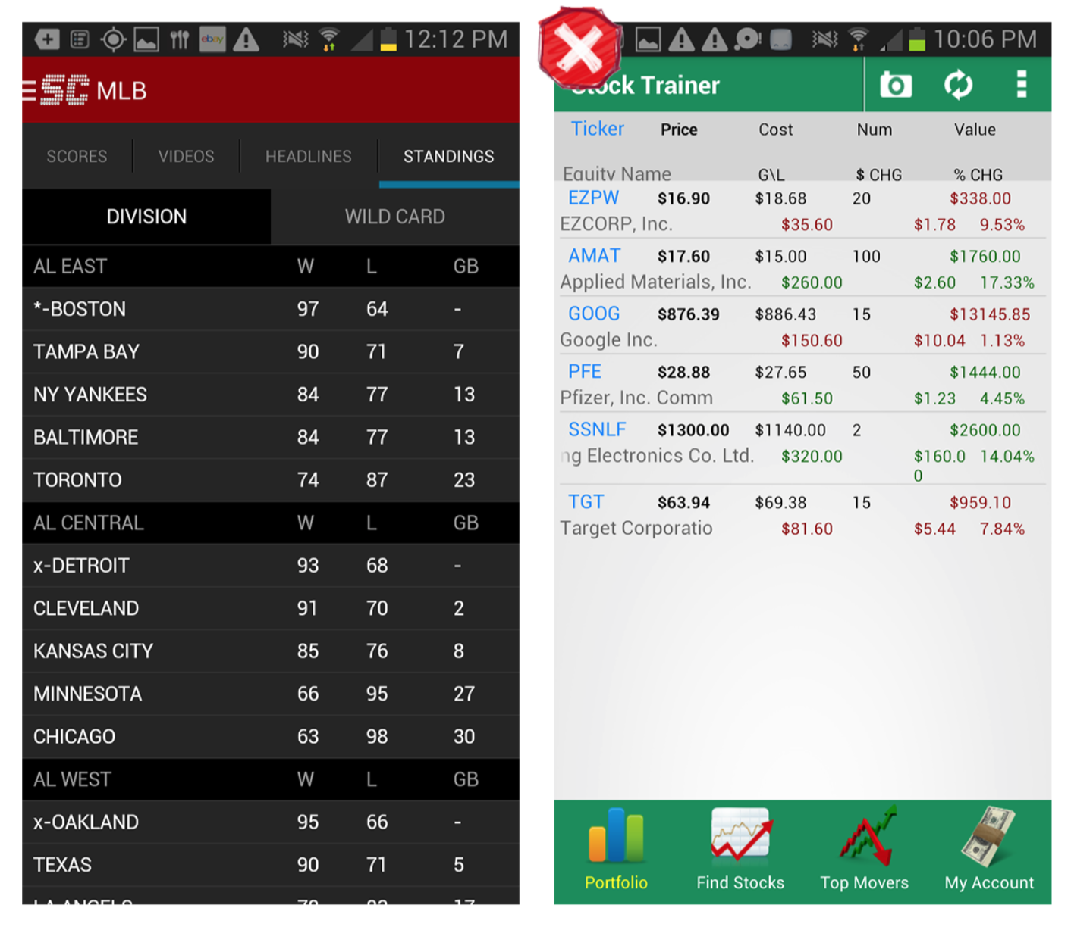
Avoid using dark gridlines; if you’re leaving out vertical gridlines, make sure the columns are aligned. Left-align text and right-align numbers. Consider an alternate pattern if there is too much information to fit on a single screen.

Slide 8
Headerless Table
The Headerless Table is characterized by fat rows displaying multiple variables for an object, and no column labels.
Headerless Tables are ideal for displaying collections of items (like inventory, recipes, albums, etc .) and search results.
It is common practice to make the row identifier—a key piece of information—stand out. BillGuard does this with icons, while Gas Guru uses a larger, darker font.

Slide 9
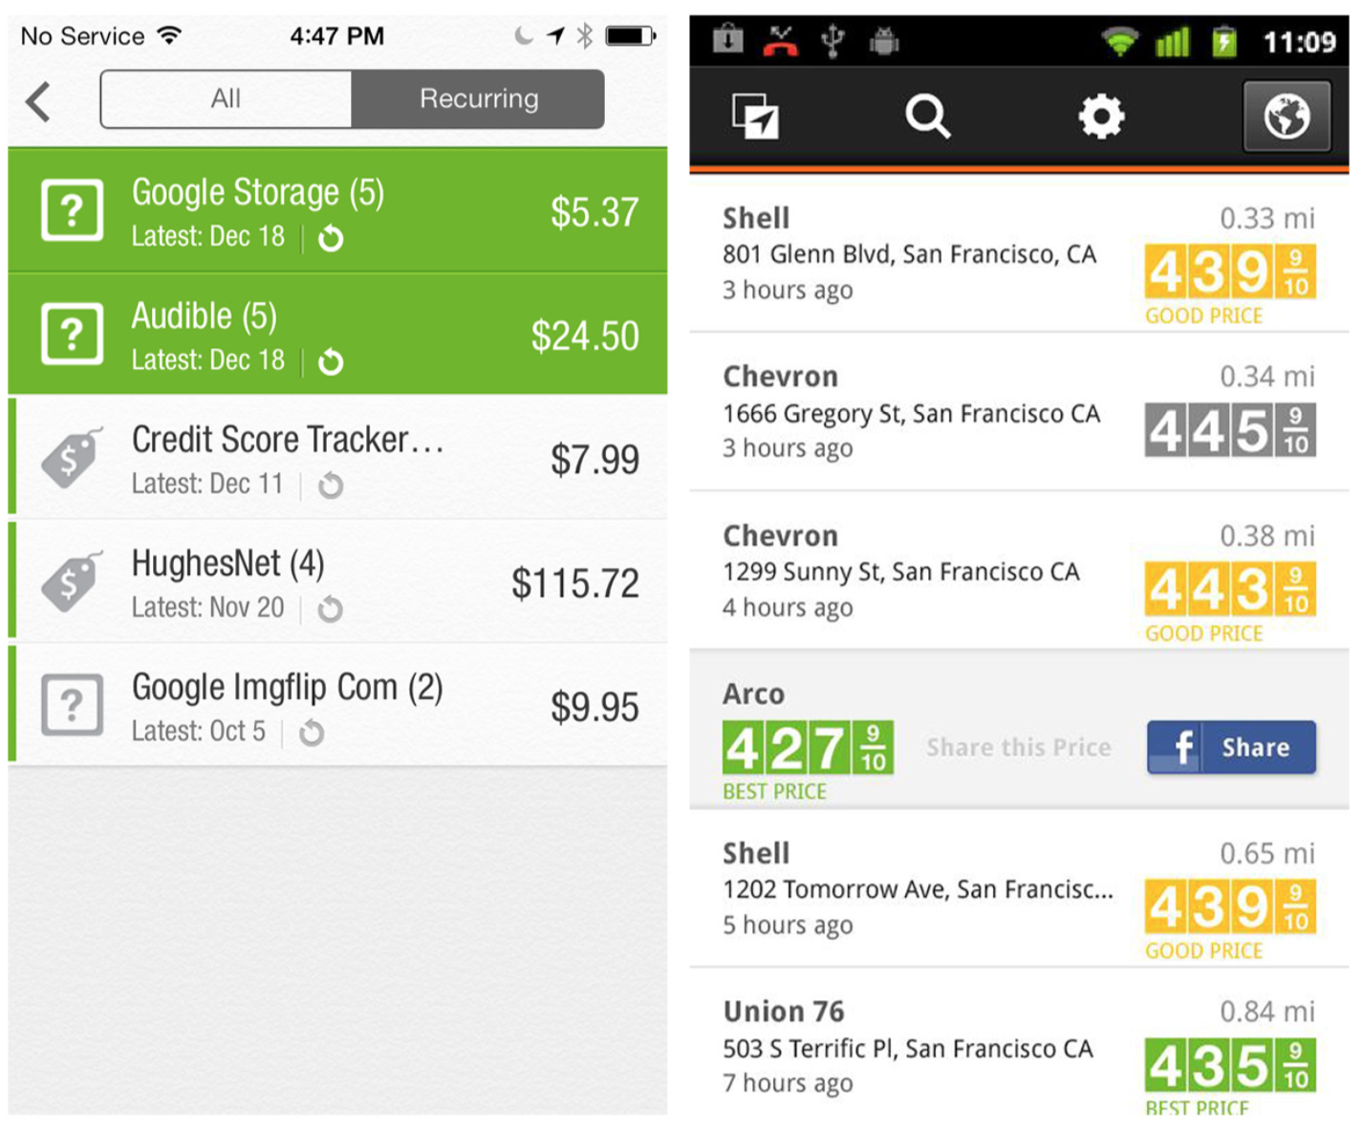

Slide 10
FlightBoard shows the flights for the selected airport . When users tap on a row, the flight details are shown inline instead of on a new screen.
Like a list, Headerless Tables are meant for quick scanning and action. The visual design elements of alignment, font, and color are critically important. See how the Realtor.com table is easier to scan than the one in Redfin, for instance.

Slide 11
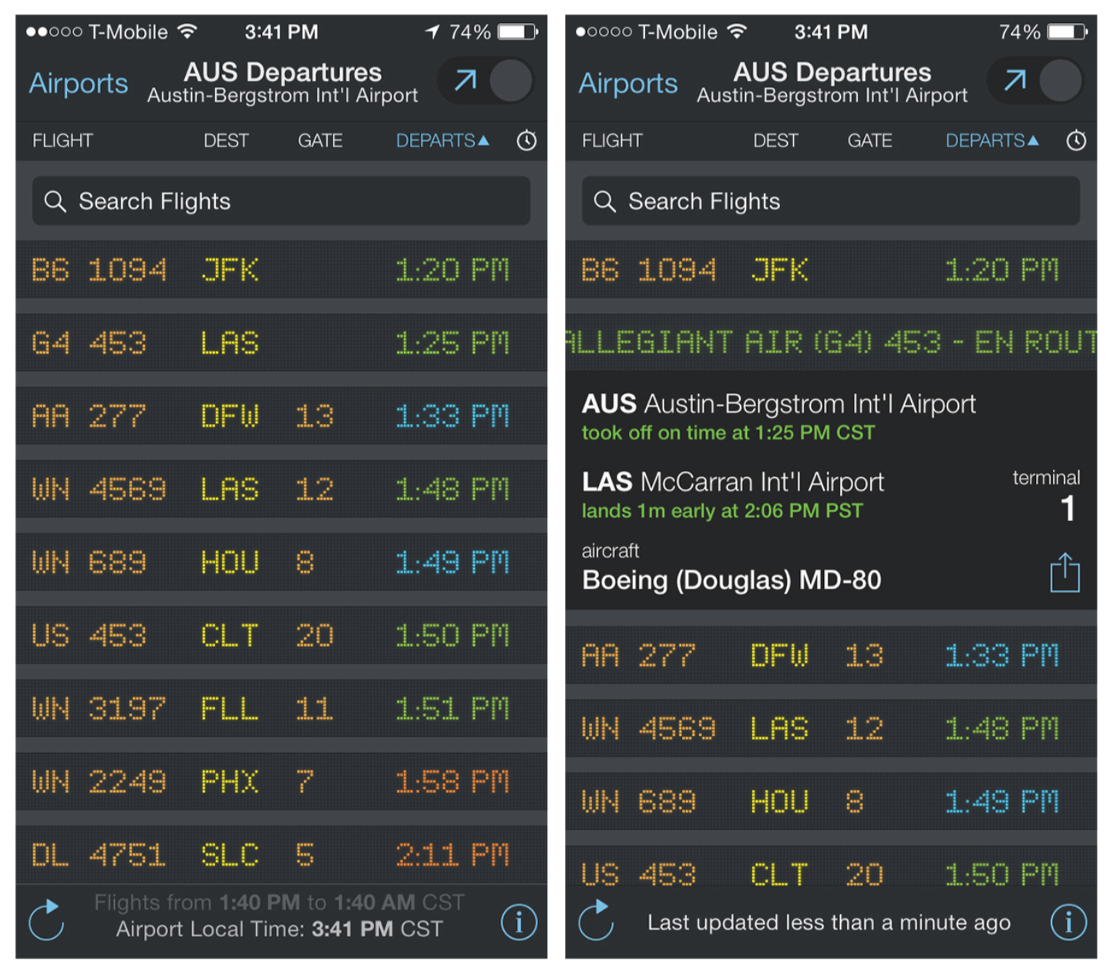

Slide 12
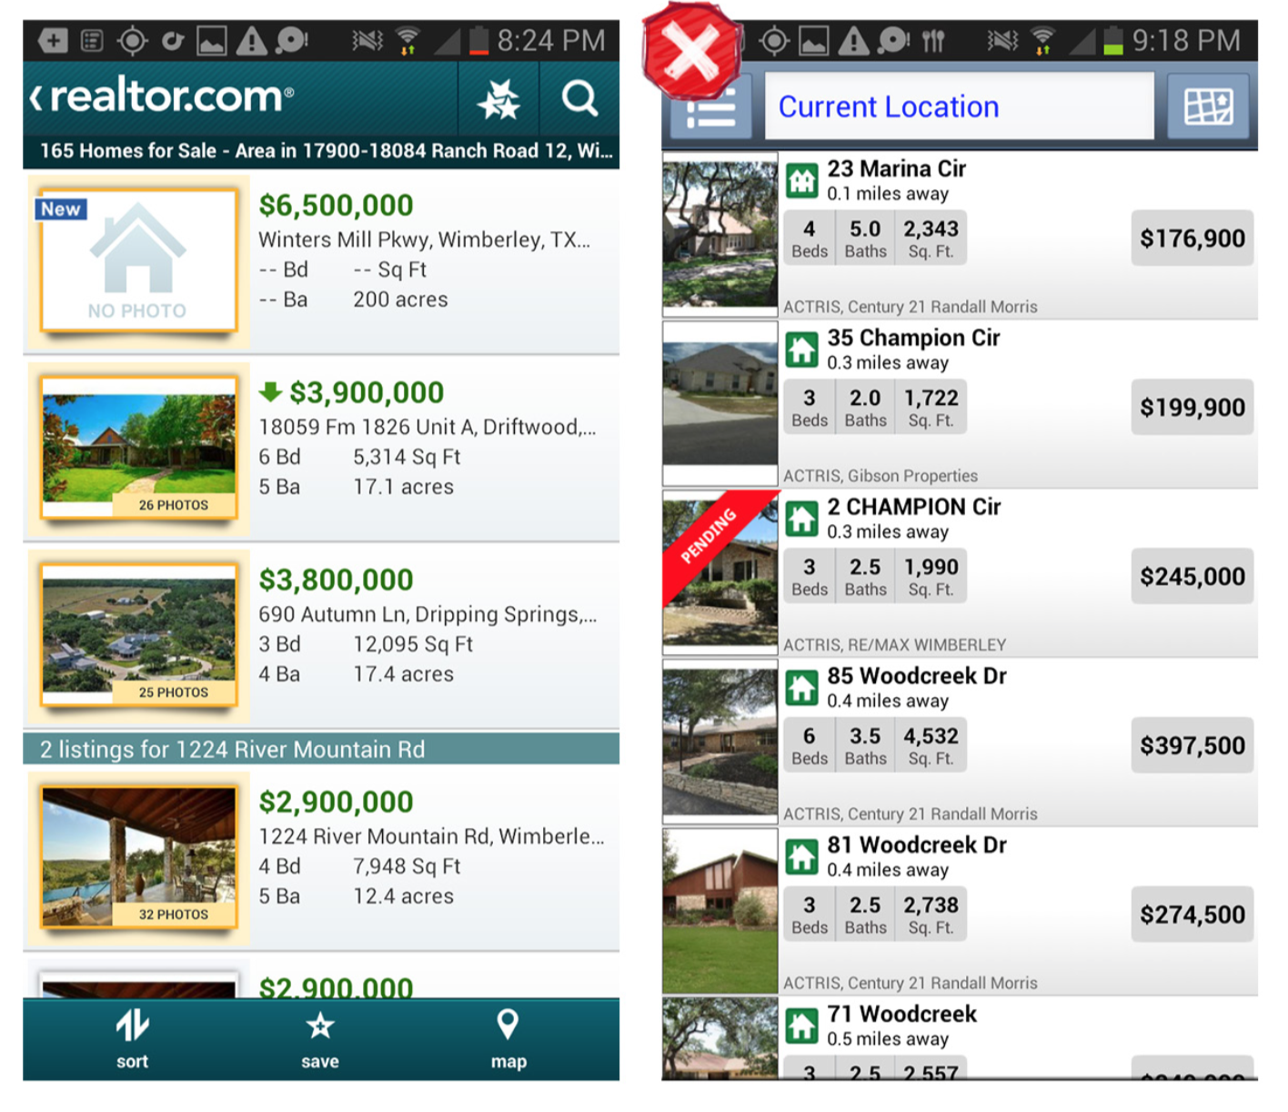
Realtor.com compared to Redfin for Android: design and alignment are critical in headerless Tables.

Slide 13
Fixed Column
For larger tables, the Fixed Column pattern may be a viable solution. In the examples from Roambi and Fidelity, when the user is not scrolling vertically, the leftmost column is fixed and the other columns swipe side-to-side.
In Roambi’s ultra-flat design, at first glance it’s a little difficult to see that the left column is fixed, but you can see that more information is available to the right. Fidelity’s design helpfully includes visual affordance that the first column is fixed and sorted.

Slide 14
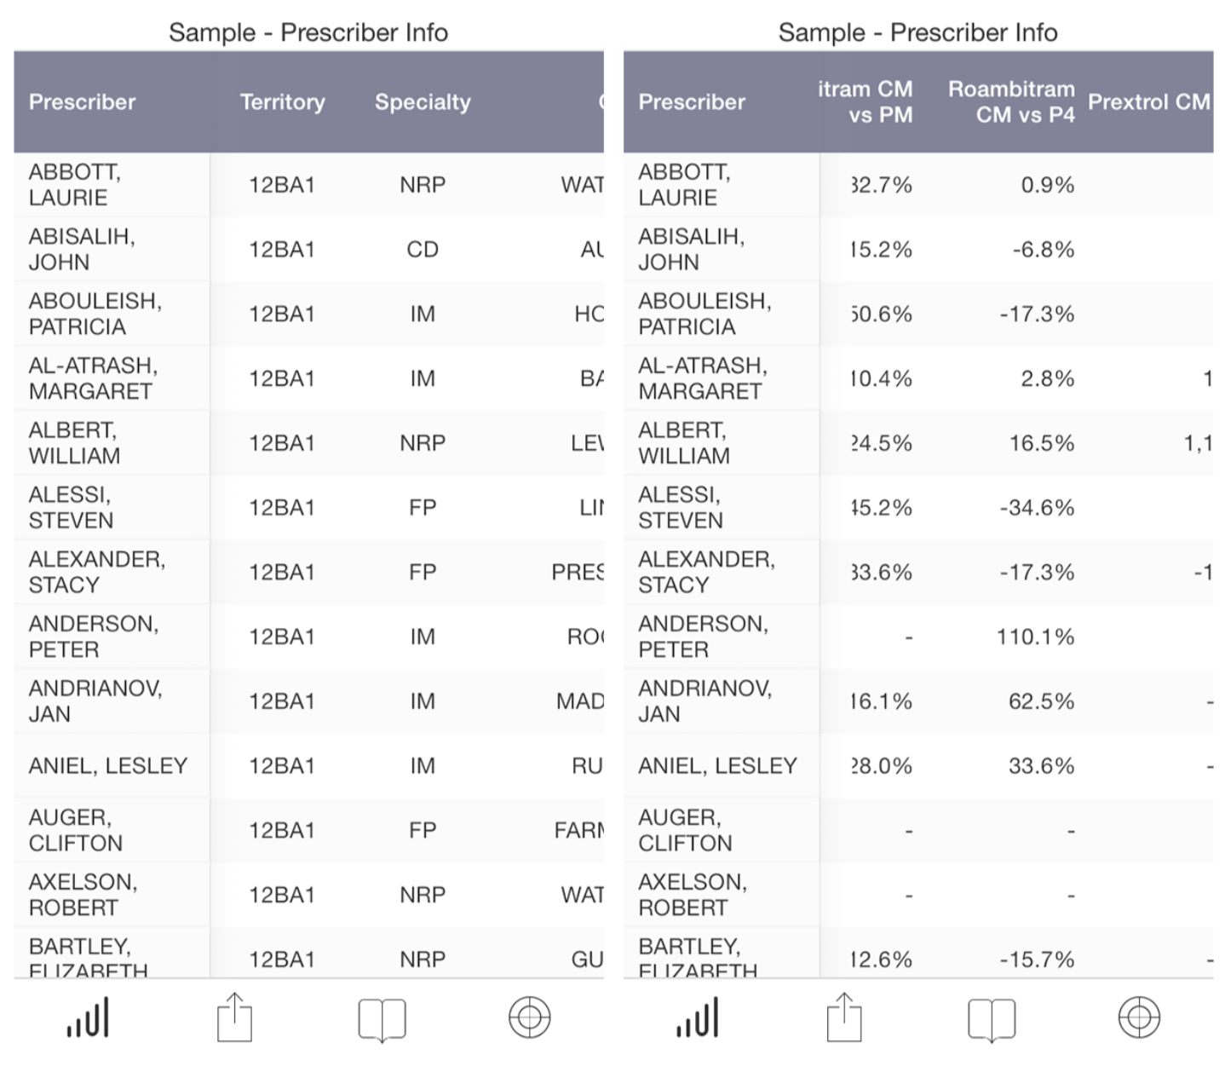

Slide 15
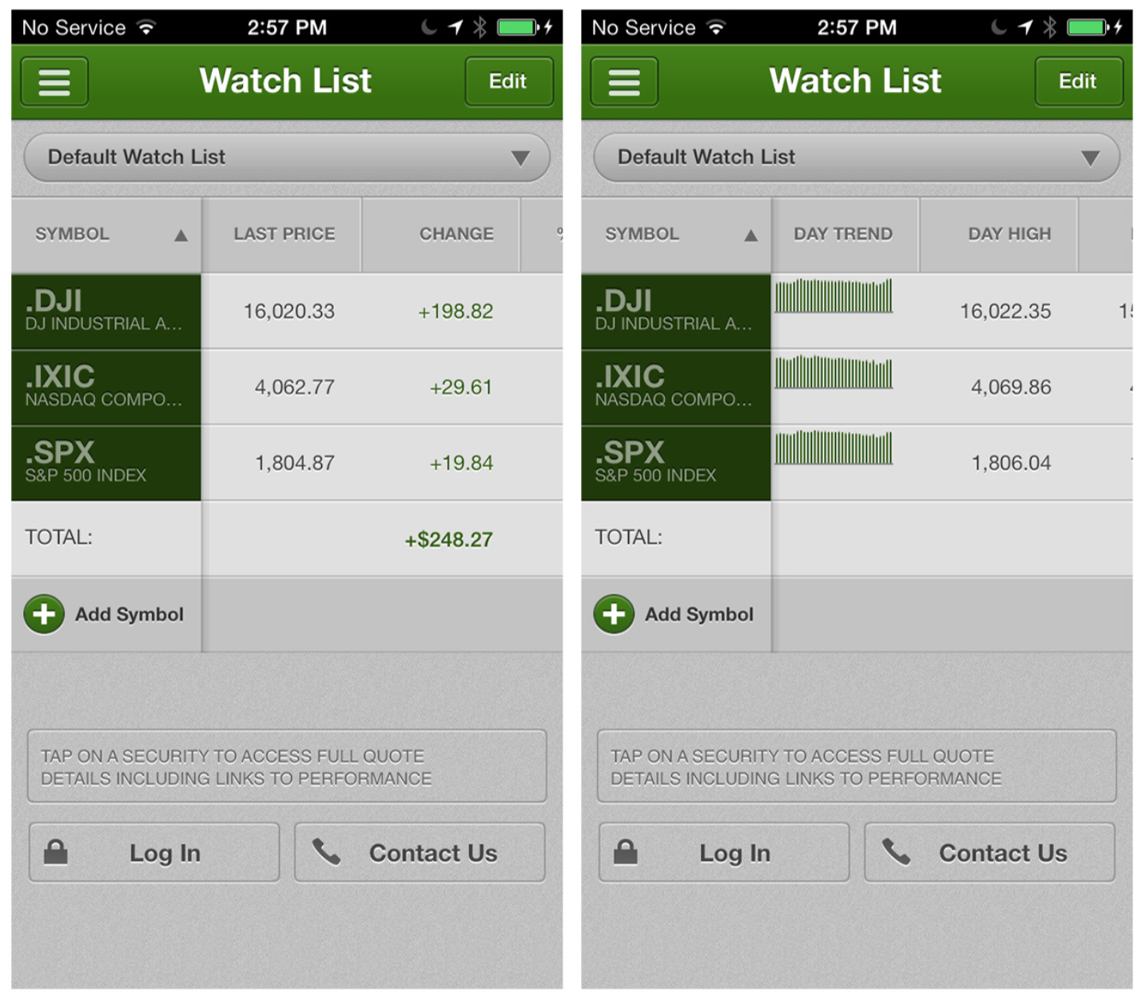

Slide 16
Overview plus Data
The Overview plus Data pattern features a summary of the table’s content displayed above the rows of data.
This is a common pattern in financial apps, but it’s useful in any app where the user wants to see totals or trends over time.
The overview can be text but is most often a chart-style graphic, as shown in the following examples.

Slide 17
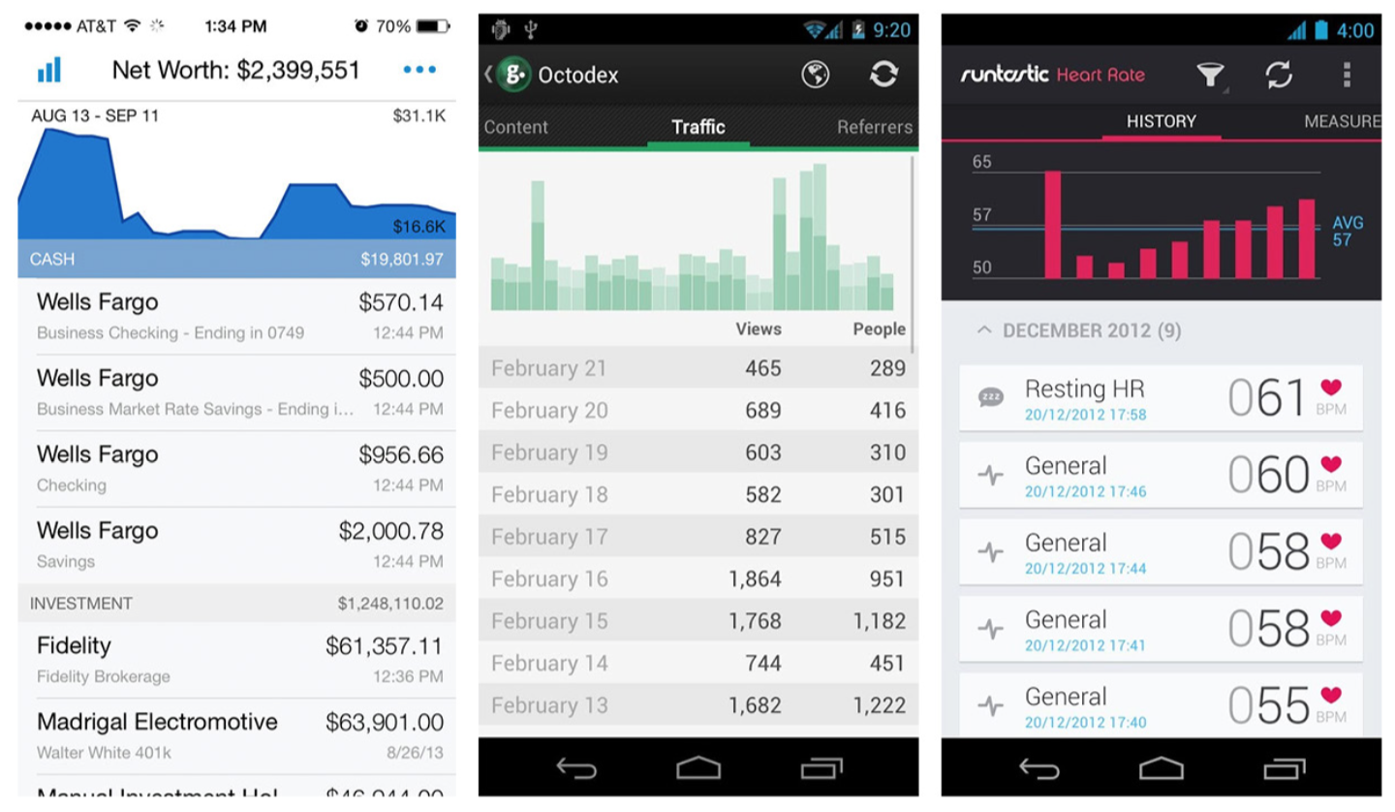
Personal Capital for iOS and Runtastic heart Rate for Android: Overviews plus Data

Slide 18
Grouped Rows
Row grouping can make it easier to read a table’s data.
Grouped Rows might serve as section headers, like transactions grouped by year (as in the Zillow Mortgage Calculator) or by category (as in Mint).

Slide 19
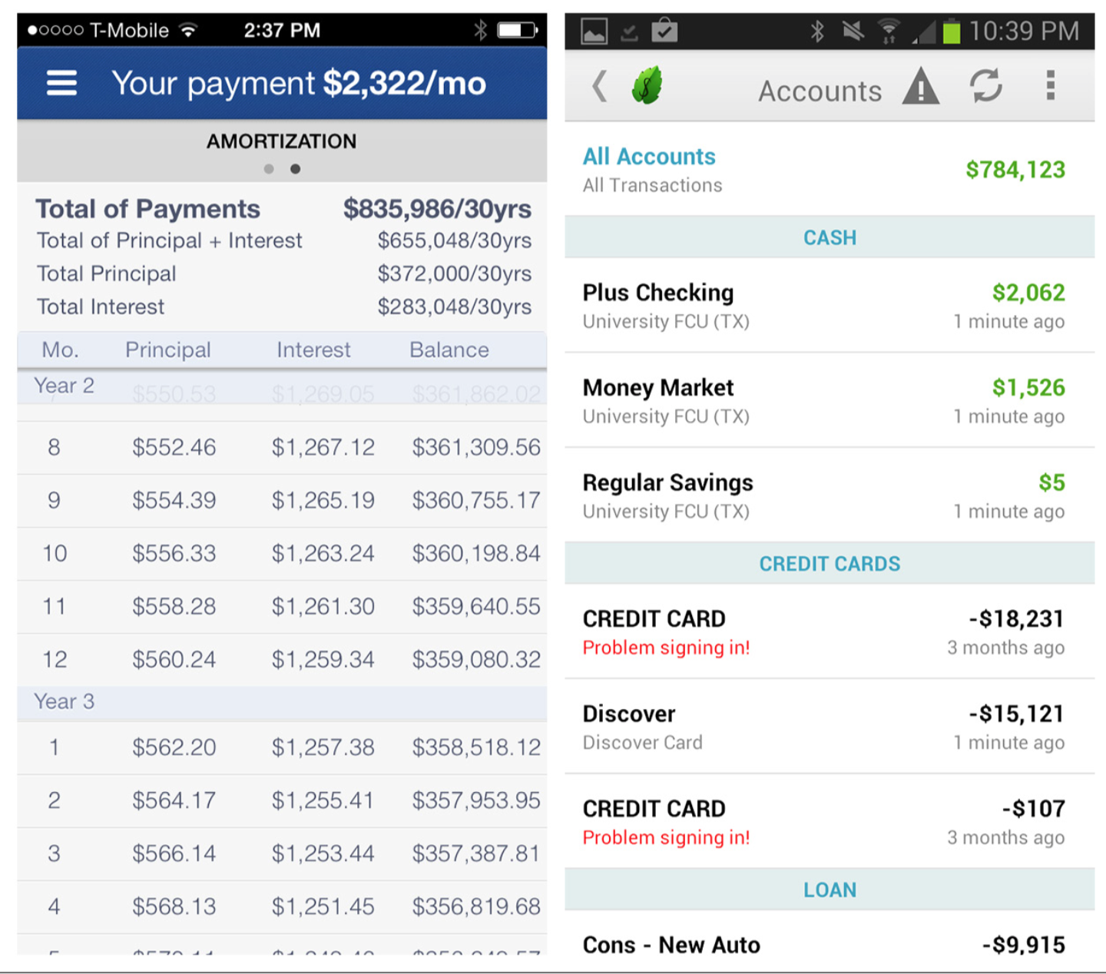

Slide 20
Table with Visual Indicators
In the Table with Visual Indicators pattern, Sparklines and icons can enhance the table’s information display, but you must be careful not to overload the table with chart junk, like in the Sleep Charts design.

Slide 21
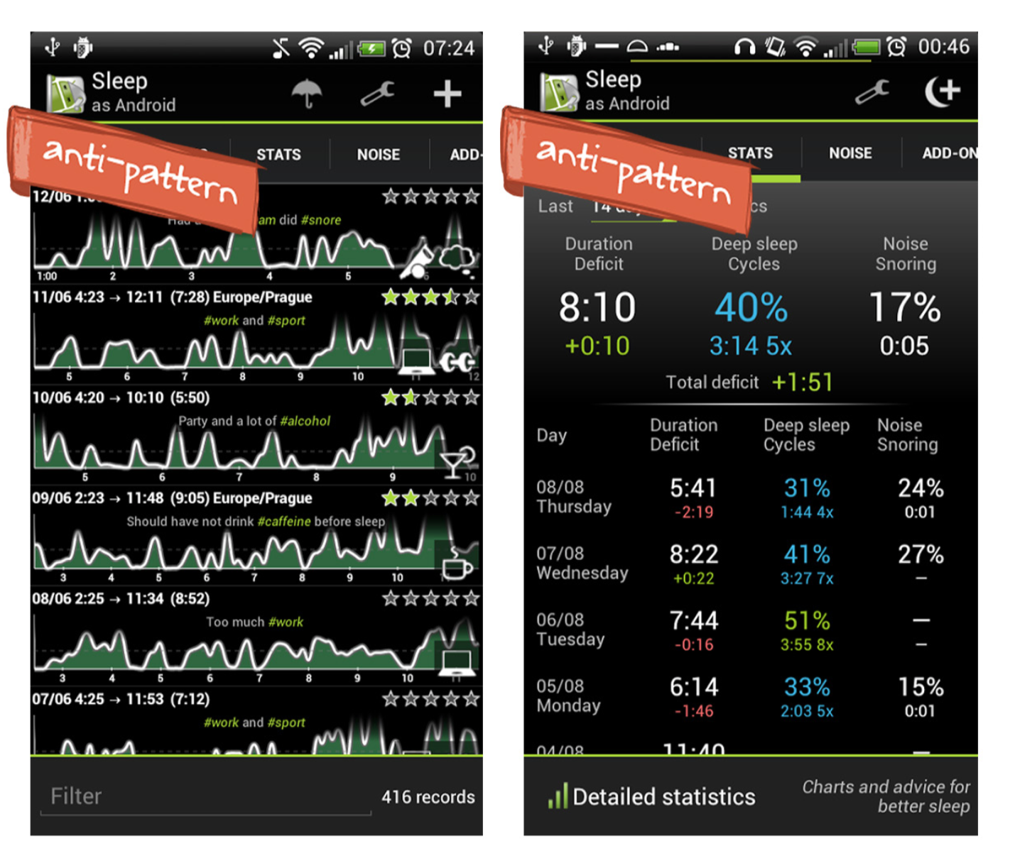

Slide 22
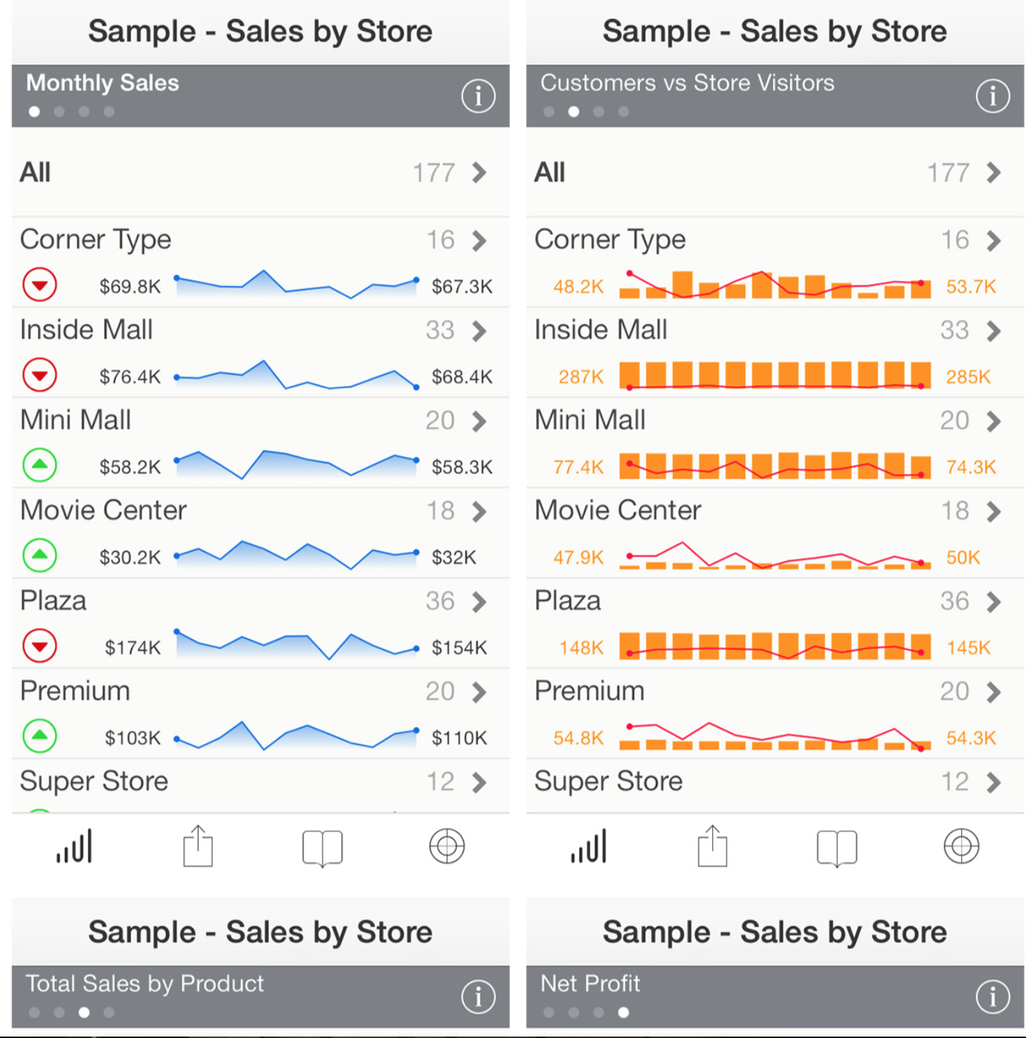

Slide 23
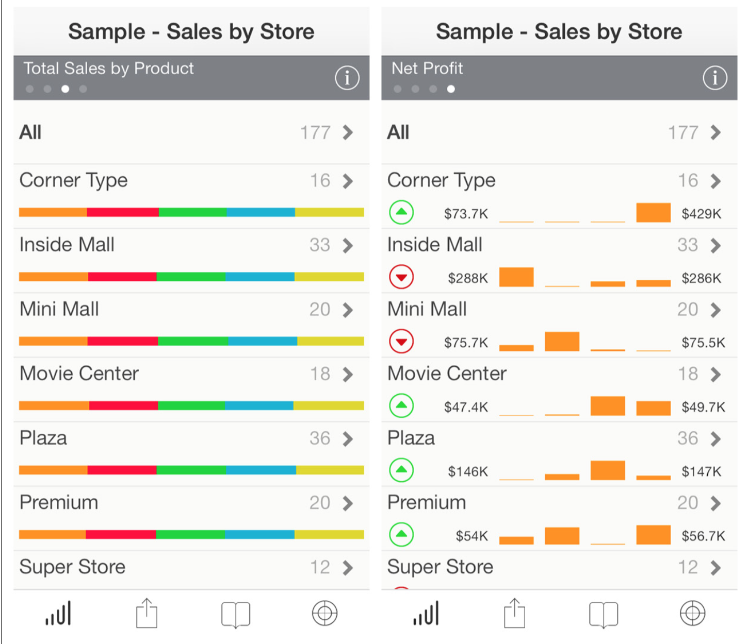

Slide 24
Choose Visual Indicators that are immediately recognizable, and once again, avoid using icons gratuitously.
Compare the last two versions of PayPal for iOS. The newer iOS 7 design has more space for the trans- action content without the excess icons.

Slide 25
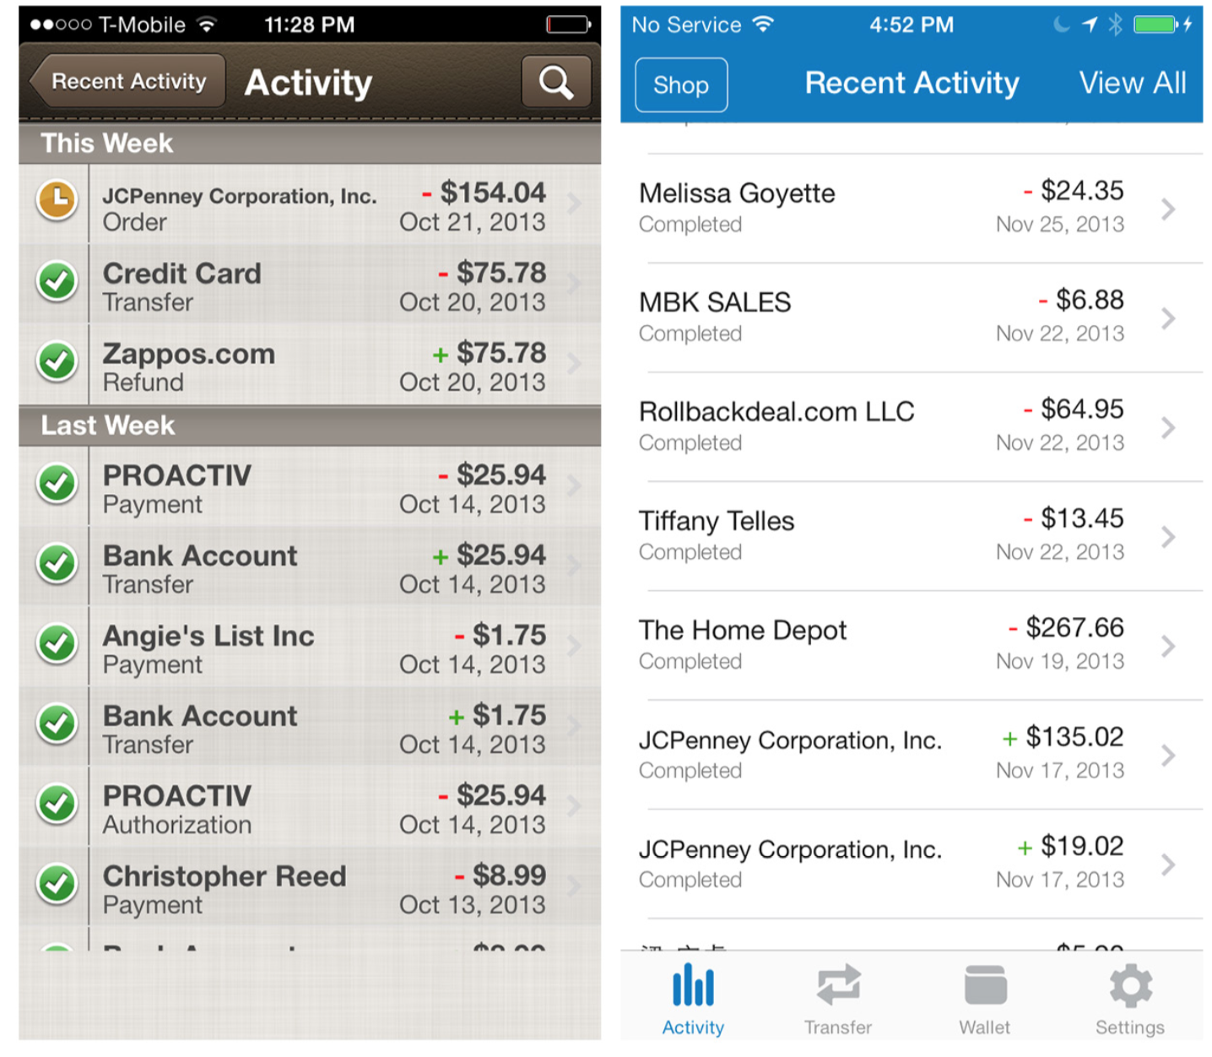
PayPal for iOS 6 and iOS 7: newer design loses the icons and gains readability

Slide 26
Editable Table
Editable Tables in mobile interfaces are found almost exclusively in spreadsheet applications like Microsoft Office, Google Drive, and Numbers . Many of the same guidelines for Editable Tables on the Web apply to mobile:
Clearly indicate the cell and/or row selected.
If there is a specific format for the cell, offer the appropriate editor
(selector, spinner, color picker, date picker, etc .).
It’s not necessary to provide confirmation feedback with each change, unless the change prompts an error message; otherwise, provide confirmations just on Save.

Slide 27
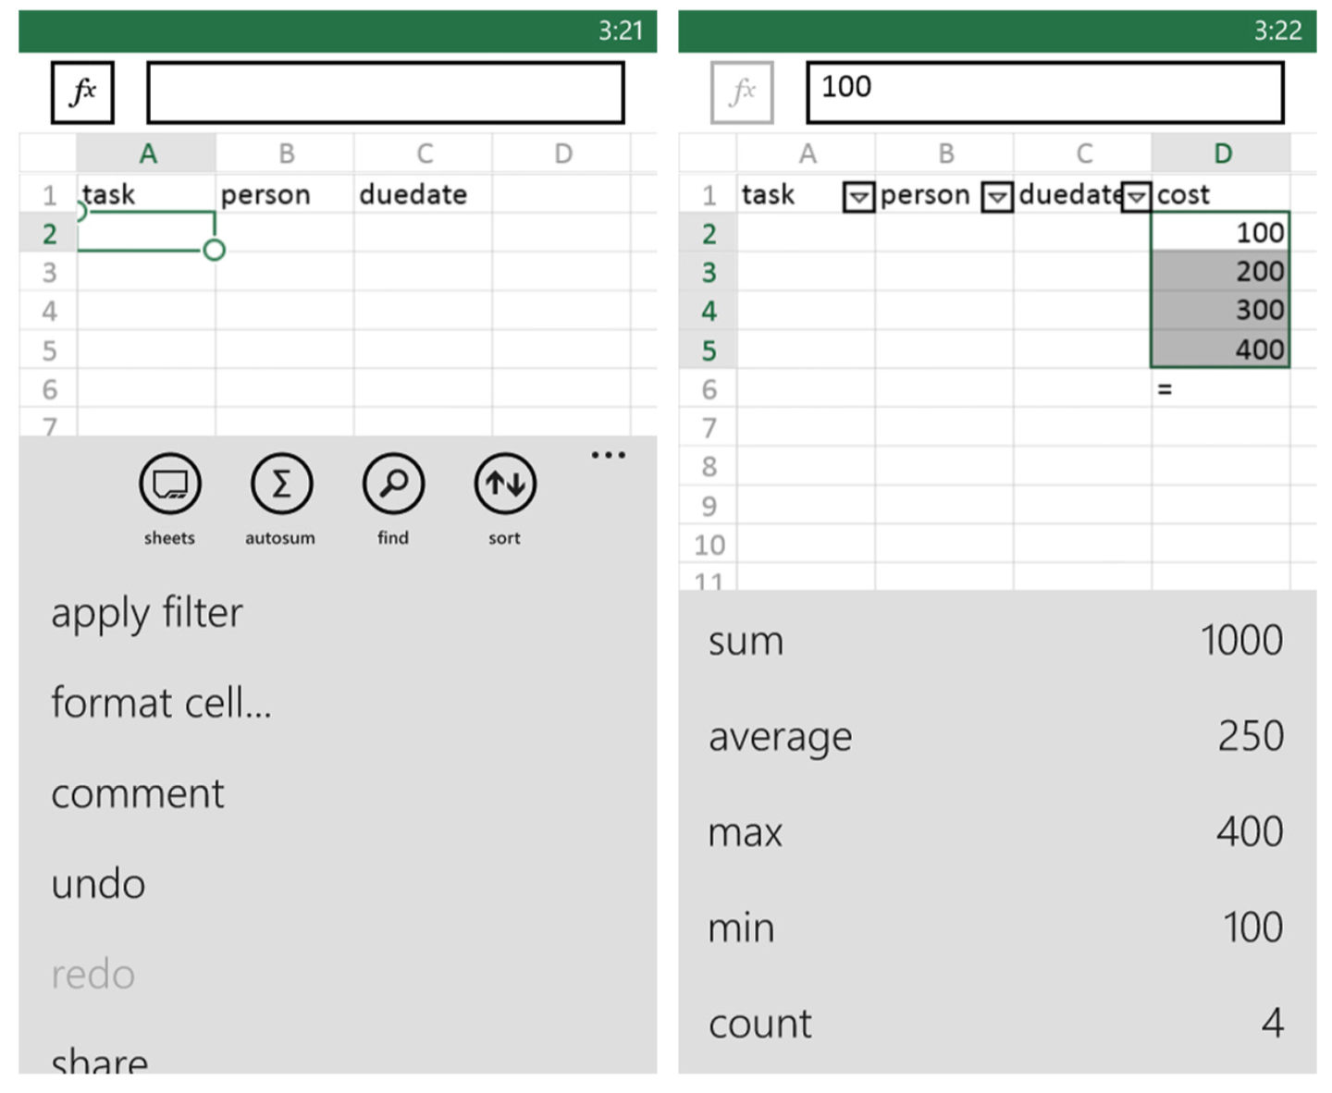
In Office for Windows Phone, single-tapping a cell presents cell menu options. Tapping the function icon (the fx at the top left) opens the functions menu.

Slide 28
Unlike on the desktop, however, Editable Tables on mobile devices are not appropriate for extensive data entry, mainly because mobile keyboards don’t support screen navigation. Specifically, you can’t tab from cell to cell.
Follow web and desktop design best practices for Editable Tables where appropriate, but avoid using Editable Tables for bulk data entry, or where extensive editing could be necessary.

Slide 29
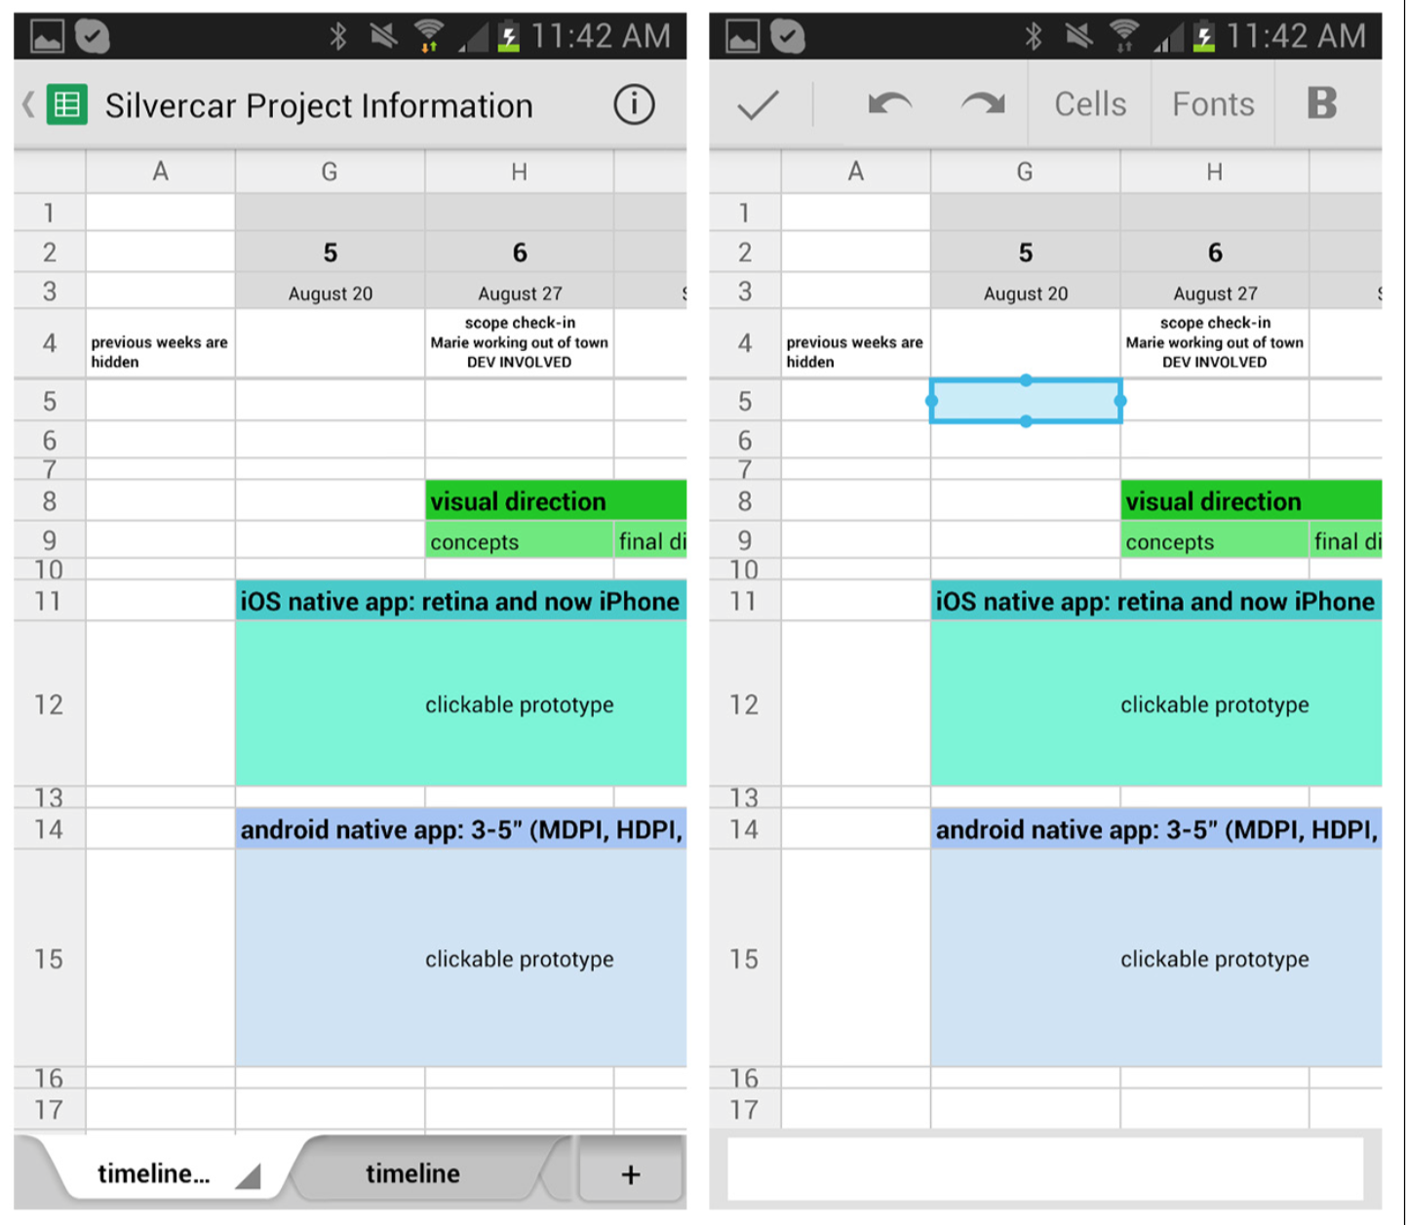

Slide 30
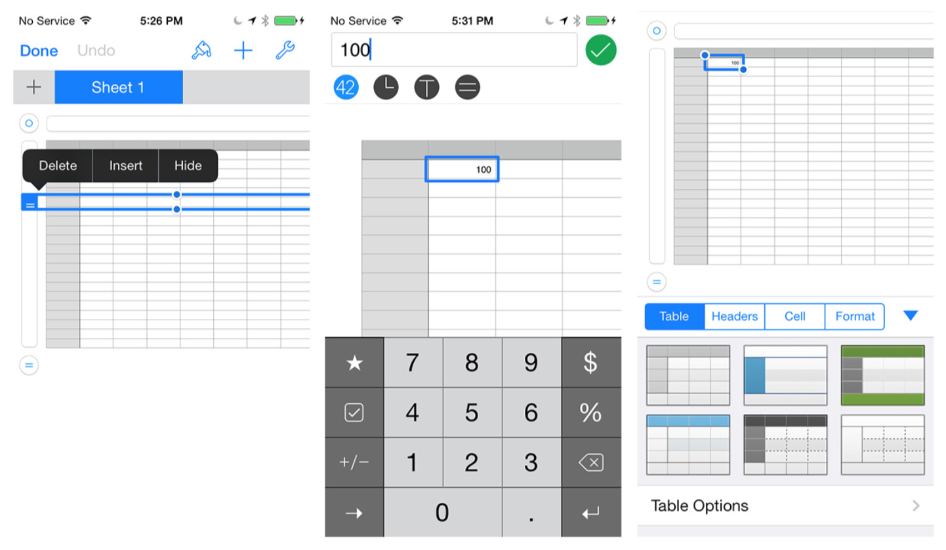

Slide 31


